Slide 1

Introduction to Ontologies
Gilles Falquet
Université de Genève,
Centre universitaire d’informatique

Slide 2
Outline
Philosophical and terminological aspects
Ontologies in computing science:
NLP, AI, IS, Semantic Web
Ontological Languages

Slide 3
Ontology and Ontologies
Ontology (philo.) The branch of metaphysics dealing with the nature of being. In particular:
Categories of being
Entities and types of entities
Relationships between entities
An ontology. Enumeration/description/organisation of existing entities.
Hierarchies of concepts
General vs. Local ontologies (for a particular field of knowledge)

Slide 4
An ontology: Some Definitions
an explicit specification of a conceptualization (Gruber)
a formal specification of a shared conceptualization
a formal, explicit specification of a shared conceptualization
a logical theory accounting for the intended meaning of a formal vocabulary, i.e. its ontological commitment to a particular conceptualization of the world (Guarino)

Slide 5
Conceptualization
create concepts
idea/mental image that corresponds to some entity or class of entity
relate concepts
typical relations
“generic/specific”, “instance/class”, “part/whole”, ...

Slide 6
A classification of ontologies
define basic notions: objects, relations, events, processes
foundational ontology
central concepts and relations of a domain, integrate different viewpoints
core reference ontology
applicable to a domain with a specific viewpoint
domain ontology
no consensus or knowledge sharing, specific to a task
application/local ontology

Slide 7
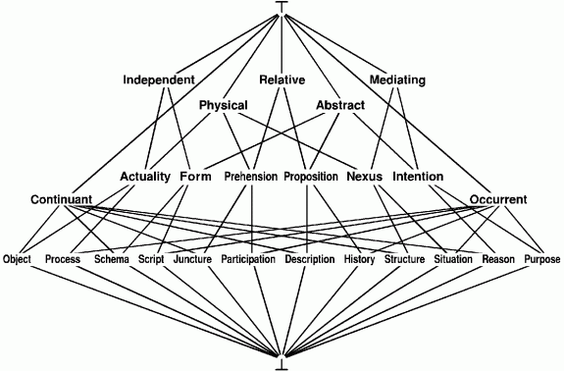
A Top Level Ontology
is-a relations
John F. Sowa. Knowledge Representation

Slide 8
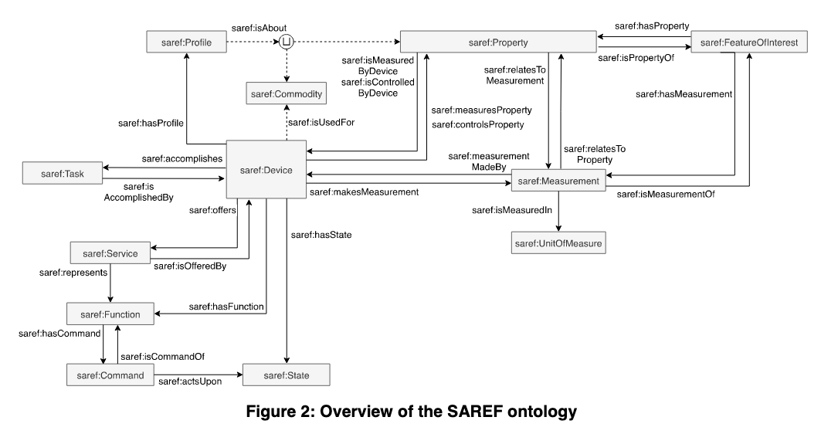
A core reference ontology
https://www.etsi.org/deliver/etsi_ts/103200_103299/103264/03.01.01_60/ts_103264v030101p.pdf

Slide 9
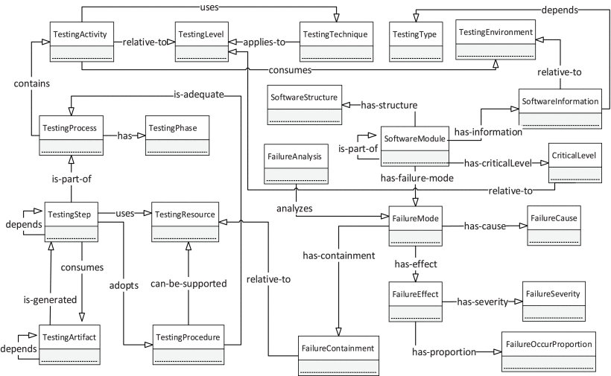
Domain ontology: Entire Process Ontology on Software Testing
https://ieeexplore.ieee.org/document/9253652

Slide 10
Specification of a conceptualization
Expression of the specification in a language
textual
graphical
…
Syntax
rules for writing correct expressions
Semantics
explicitly defined in mathematical terms → formal language
explicitly defined in natural language(+math) → semi-formal
not defined, suggested, implicit → informal

Slide 11
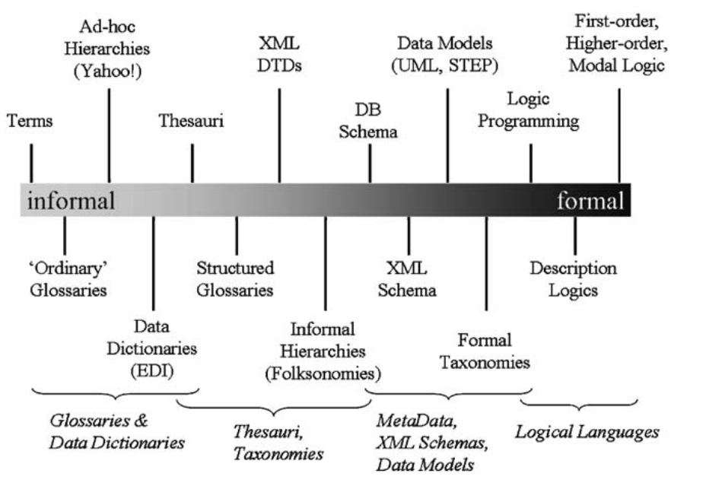
Ontology expression
https://www.iaoa.org/isc2012/docs/Guarino2009_What_is_an_Ontology.pdf

Slide 12
Some semi-formal languages
language | concept expression | relation expression | complex relations
XML schema | element type definition | subtype, element inclusion, reference attributes | number restrictions (min/max occurs)
relational DB schema | not explicit some tables (in general) | not explicit, foreign keys, some tables | integrity constraints expressed in SQL Datalog rules
UML | class | association, inheritance, composition | number restrictions (min/max occurs) + Object Constraint Language

Slide 13
Formal Languages for Ontologies
First order logic
propositional logic
predicate logic
Description logics
a family of logics
designed to formalize class diagrams and other class-oriented and frame-based languages

Slide 14
Why Formal Expressive Ontology Languages ?
to formally express complex relationships / domain rules
"a vegan pizza is a pizza whose ingredients are all vegan"
if Parent(x, y) and Parent(y, z) then GrandParent(x, z)
the notion of consistency is well defined
the notion of logical entailment is well defined
if the language is not too expressive
consistency and entailment can be automatically checked

Slide 15
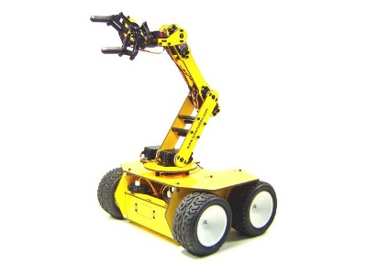
A cube is an object
A tetrahedron is an object
Two objects cannot be at the same place
A cube cannot stand on a tetrahedron
An object cannot be moved if there is another object on top of it
a
b
“Put a on b !”

Slide 16
First Order Logic
Axioms
1. ∀x Cube(x) ⇒ Object(x)
2. ∀x ∀y Object(x) ⋀ Object(y) ⋀ x ≠ y
⇒ location(x) ≠ location(y)
3. ∀x ∀y On(x, y) ⇒ ¬ Movable(y)
a
b

Slide 17
First Order Logic
Highly expressive
e.g. every algorithm is expressible in FOL
Difficult to understand and master the formalism
Not decidable
no algorithm to decide (always in finite time) if
a formula is equivalent to another one
a formula is a consequence of another formula
a set of formulae contains a contradiction
"Semi decidable"
algorithms answer “yes”, “no”, or run forever

Slide 18
Well known ontologies in FOL
Foundational ontologies / Top level ontologies/ Upper Level Ontologies
generic ontologies applicable to various domains
define basic notions like objects, relations, events, processes, …
SUMO
CyC
DOLCE

Slide 19
SUMO
Foundational ontology
Largest free, formal ontology available, with ~25,000 terms and ~80,000 axioms
Language: SUO-KIF <-> First order logic

Slide 20
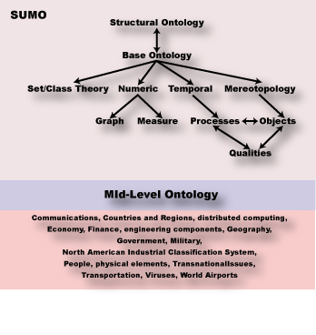

Slide 21
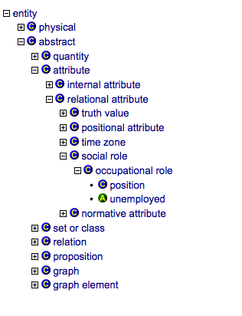
http://virtual.cvut.cz/kifb/en/toc/root.html

Slide 22
Axioms related to 'entity'
There exists thing so that thing is an instance of entity.
∃T instance(T, Entity)
If class is an instance of class, then class is a subclass of entity.
instance(C, Class) ⇒ subclass(C, Entity)

Slide 23
The CyC Project
Build a theory of commonsense, to add AI to all computer programs
In first order logic
Currently millions of axioms
Grouped in coherent “microtheories”: geometry, physics, movement, transport, …(some freely available)
Partial reasoning system

Slide 24
DOLCE
WonderWeb Deliverable D17 The WonderWeb Library of Foundational Ontologies
Preliminary Report
Claudio Masolo, Stefano Borgo, Aldo Gangemi, Nicola Guarino, Alessandro Oltramari, Luc Schneider ISTC-CNR c/o ISIB-CNR, C.so Stati Uniti, 4 35127 Padova Italy

Slide 25
DOLCE
"We do not commit to a strictly referentialist metaphysics related to the intrinsic nature of the world"
"[Our categories] are just descriptive notions that assist in making already formed conceptualizations explicit. [...]. In other words, our categories describe entities in an ex post way, reflecting more or less the surface structures of language and cognition."
"DOLCE is an ontology of particulars, in the sense that its domain of discourse is restricted to them. [...] particulars are entities which have no instances; universals are entities that can have instances. Properties and relations (corresponding to predicates in a logical language) are usually considered as universals. "

Slide 26

Main categories
Endurants
can “genuinely” change in time
the very same endurant as a whole can have incompatible properties at different times;
my computer was working yesterday
my computer is down today
statements about what parts it has must be made relative to some time or other
my computer has a 1Tb hard disk, but I will replace it tomorrow

Slide 27
Perdurants
events, processes, ...
endurants need a time- indexed parthood, while perdurants do not
“my youth is part of my life”
"Italy is the winner of the worldcup 2020"
"Algol 68 is a programming language"
do not require a time specification

Slide 28
Qualities
Qualities inhere to entities: every entity comes with certain qualities, which exist as long as the entity exists.
a quality
the color of a specific rose
must be distinguished from its quale (value)
a particular shade of red.
a quale describes the position of an individual quality within a certain conceptual space (quality space)

Slide 29
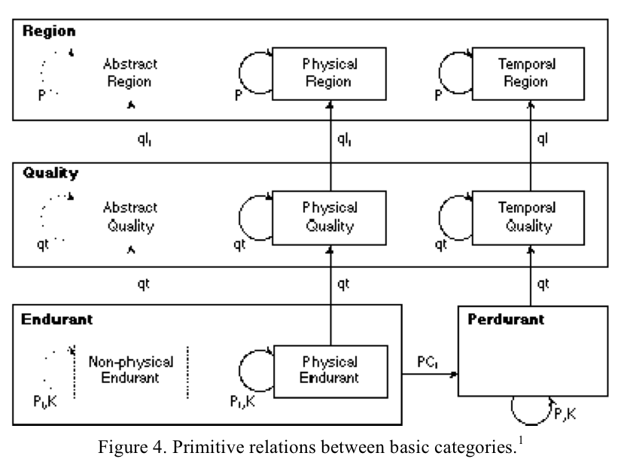
Relations in DOLCE

Slide 30
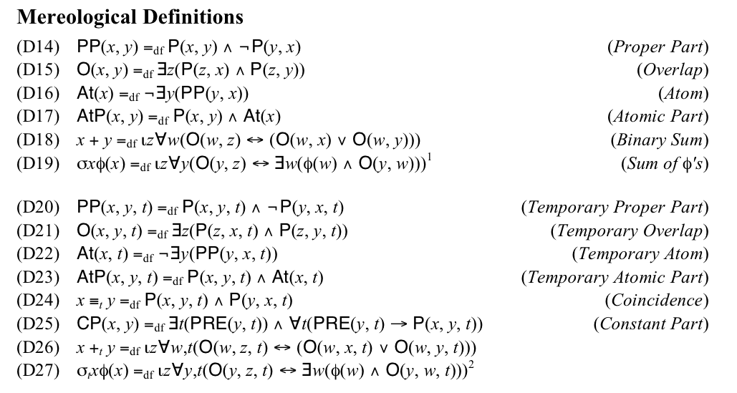
Axioms (sample)

Slide 31
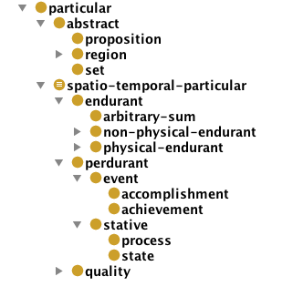
Concept hierarchy
∀x abstract(x)→particular(x)
∀x proposition(x)→abstract(x)
etc.
DOLCE Light in OWL

Slide 33
Description Logics (DL)
A family of logic languages (fragments of FOL)
“Reasonably” expressive
Less expressive than predicate logics
More expressive than UML class diagrams
Reasoning can be automated in many DLs
Ontology
vocabulary of classes, properties, and individuals
axioms
concept definitions and inclusions
concept instances (individuals)

Slide 34
Ontologies in DL
Top level foundational ontologies
BFO
DOLCE (Light)
CCO
Core ontologies
FMA (foundational model of anatomy, 104721 classes)
OWL-S (web services)
CityGML, IFCOWL (translated from other models)
Specific (application) ontologies
see for instance https://bioportal.bioontology.org/ontologies/

Slide 35
Common Core Ontologies
Realism: an ontology should be designed to model not only data, but also, more importantly, the entities in the world that data refers to.
Conviction: disparate ways of capturing data are best rendered interoperable by rendering them conformant to the ways things actually are in reality.
Any given assertion in an ontology can be evaluated on the basis of an objective criterion: Is the assertion true?
A distinction between representations of real entities and representations of information entities. For example, it allows one to distinguish explicitly between
a representation of a patient John Doe (repr. of a real person) and
a representation of the electronic medical records that are about John Doe ((fallible) repr. of data about the real person).
https://github.com/CommonCoreOntology/CommonCoreOntologies

Slide 36
Reasoning in DL
Most DLs are decidable fragments of FOL
Decidable reasoning tasks
consistency
subsumption (C subclass of D?)
instance checking (x instance of C?)
Restricted DLs for efficient reasoning
OWL2-RL (rule-based reasoners)
OWL2-QL (SQL reasoners)

Slide 37
Rule extensions
To increase the expressive power of the language
Not in the standard DL semantics
SWRL rule language
SPARQL DL:
OWL inference
SPARQL on the inferred RDF graph

